Slide 1

Uber
Unsupervised Machine Learning
Anh Huynh & Aadil Ben Rachid

Slide 2

Contents
Uber trip Data
In August
Clean data with EDA
Visualizations
unsupervised machine learning.
Elbow method
Agglomerative
Deliverables
Folium maps
Predict on September
Import data
Kmeans
DBSCAN
Models implementation & comparison

Slide 3
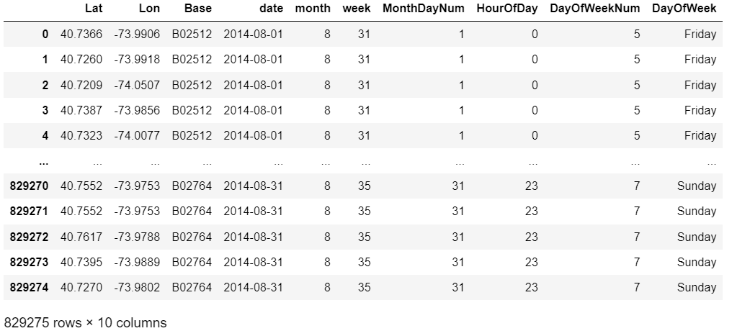
New Dataset

Slide 4
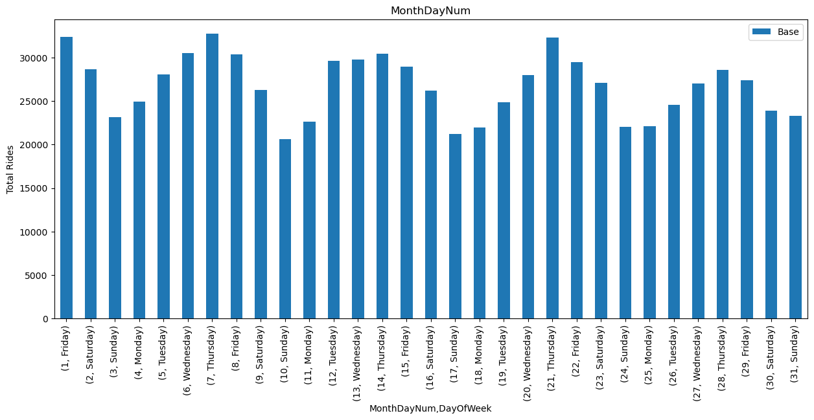
Daily rides of the month

Slide 5
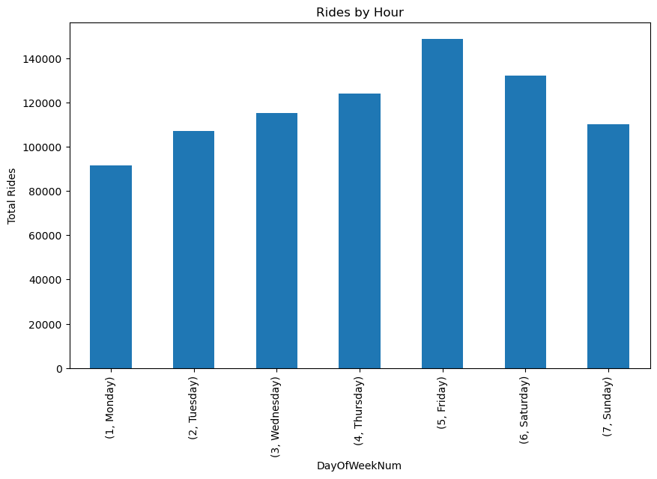
Daily rides in a week

Slide 6
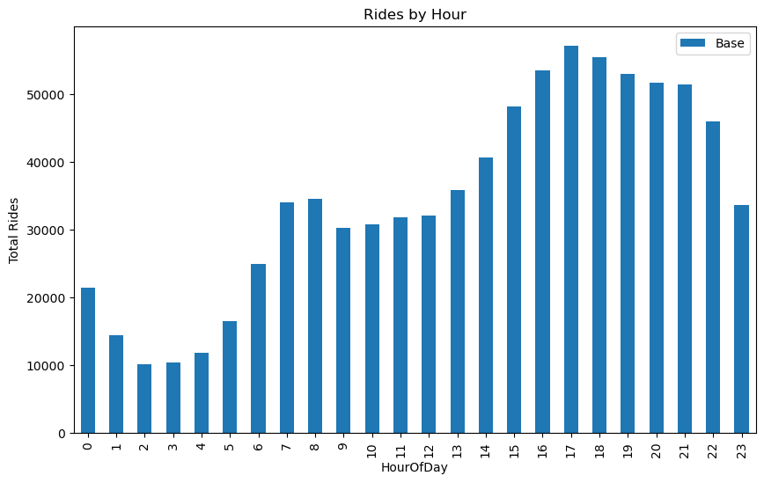
Hourly rides

Slide 7
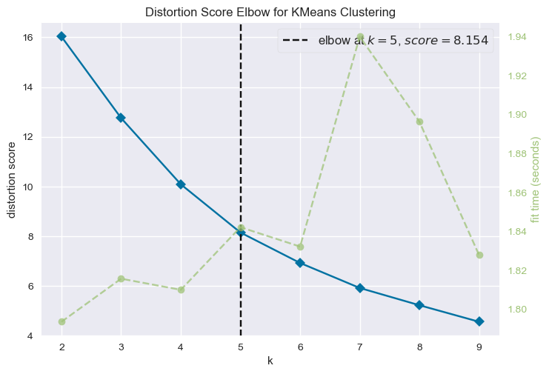
Elbow method to define number of clusters
X=data.sample(frac=0.005)
X=X[["Lat","Lon"]]
model = KMeans()
visualizer = KElbowVisualizer(estimator = model, k = (2,10))

Slide 8
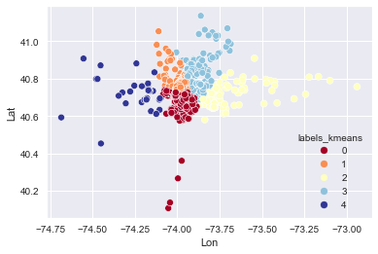
KMEANs
kmeans = KMeans(n_clusters=5, max_iter=100)
kmeans.fit(X)
y_kmeans = kmeans.predict(X)
y_kmeans

Slide 9
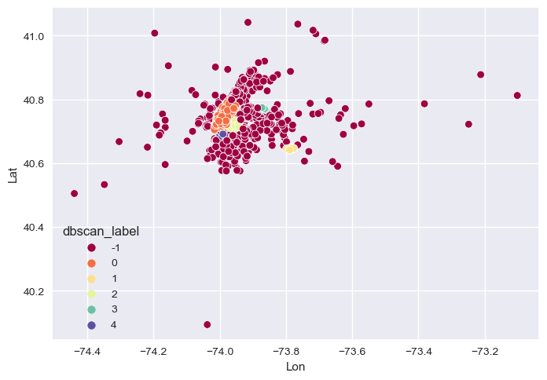
DBSCAN
X1=X[["Lat","Lon"]]
dbscan = DBSCAN(eps=0.009, min_samples=50,n_jobs=-1)
dbscan.fit(X1)
y_dbscan = dbscan.fit_predict(X1)
y_dbscan

Slide 10
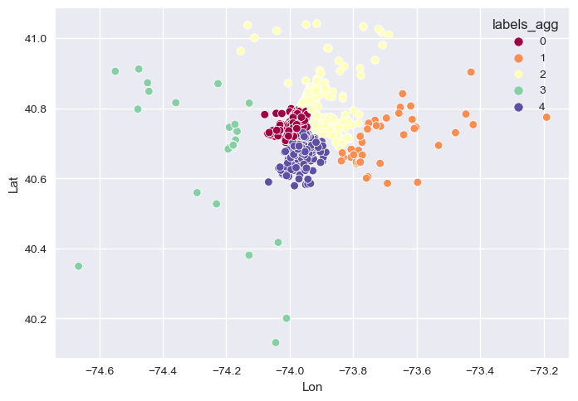
Agglomerative
X2=X[["Lat","Lon"]]
agg = AgglomerativeClustering(n_clusters=5, affinity='euclidean', linkage='ward’)
y_agg=agg.fit_predict(X2)

Slide 11
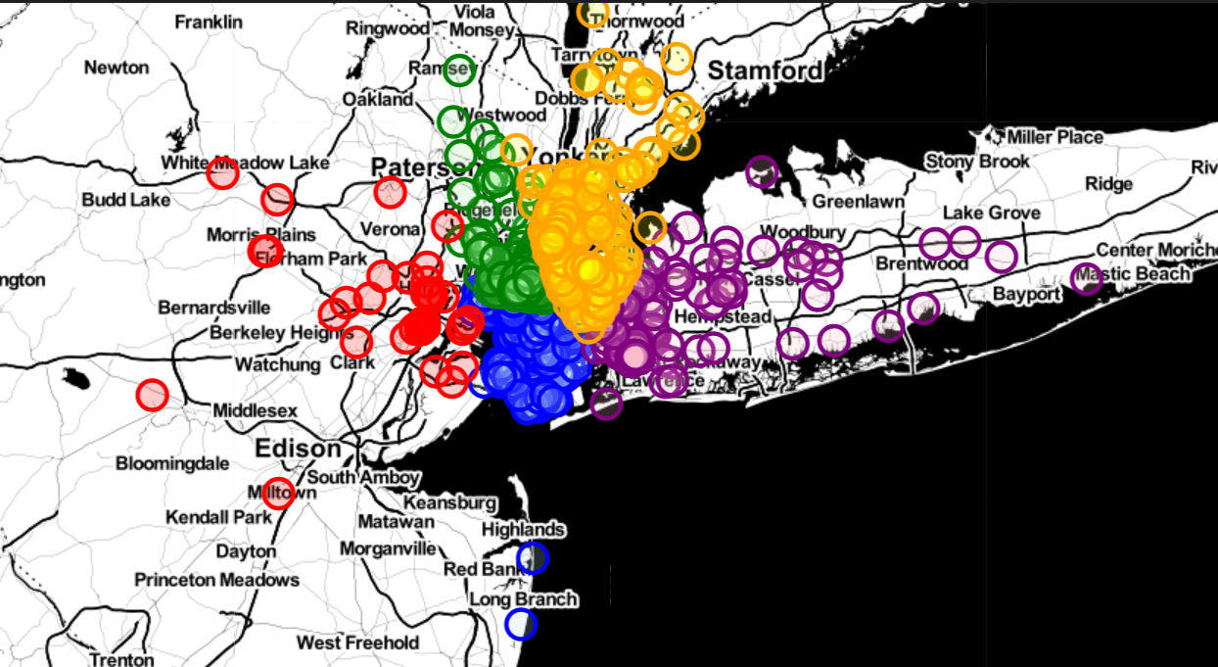
Folium maps for kmeans

Slide 12
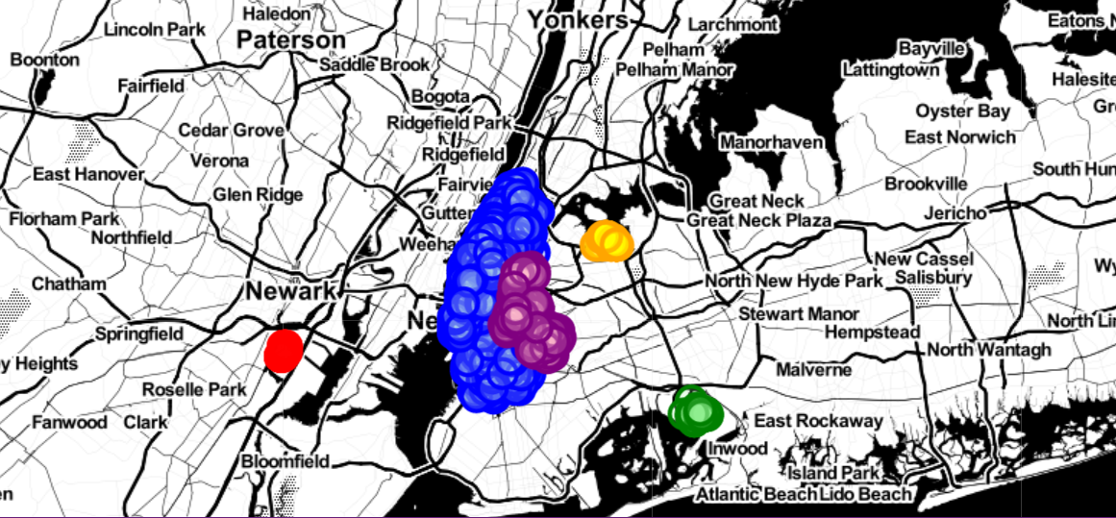
Folium maps for DBSCAN

Slide 13
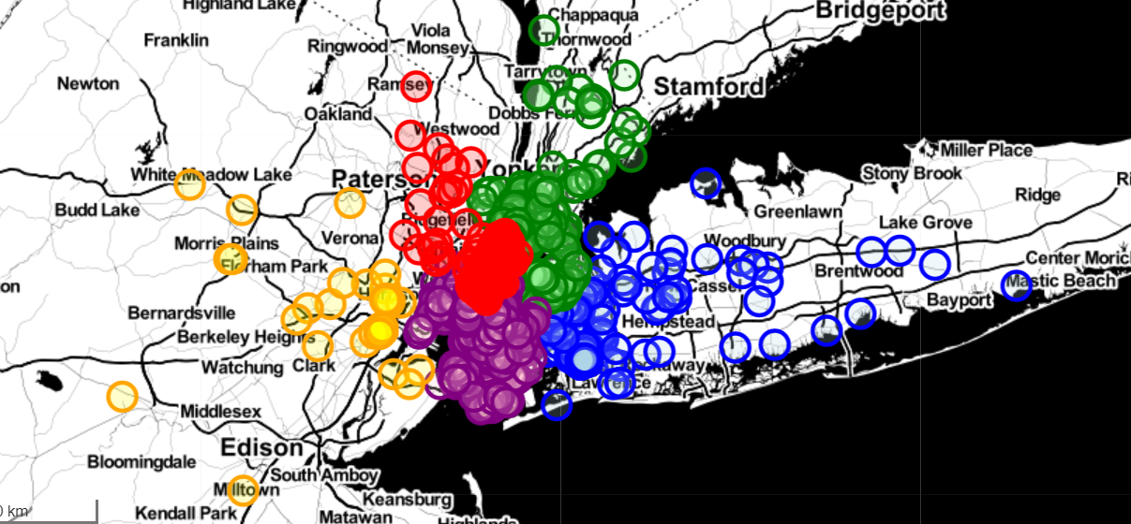
Folium maps for Agglomerative

Slide 14
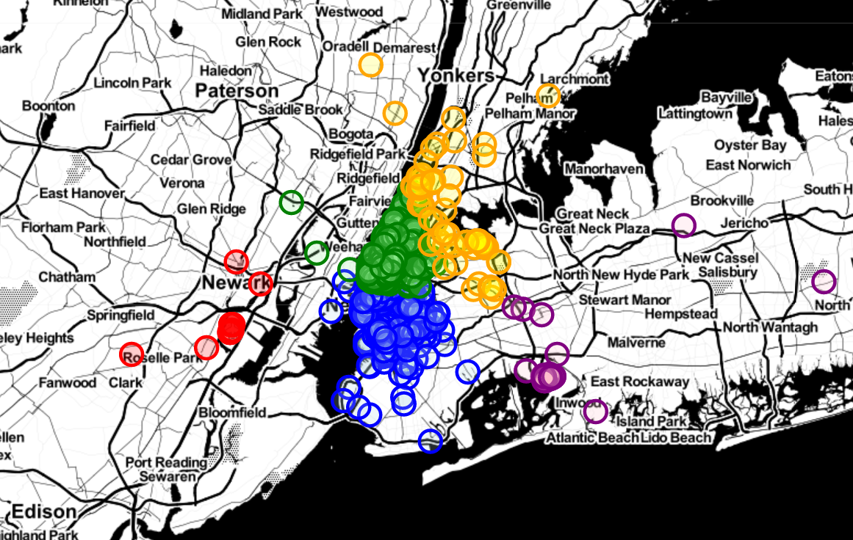
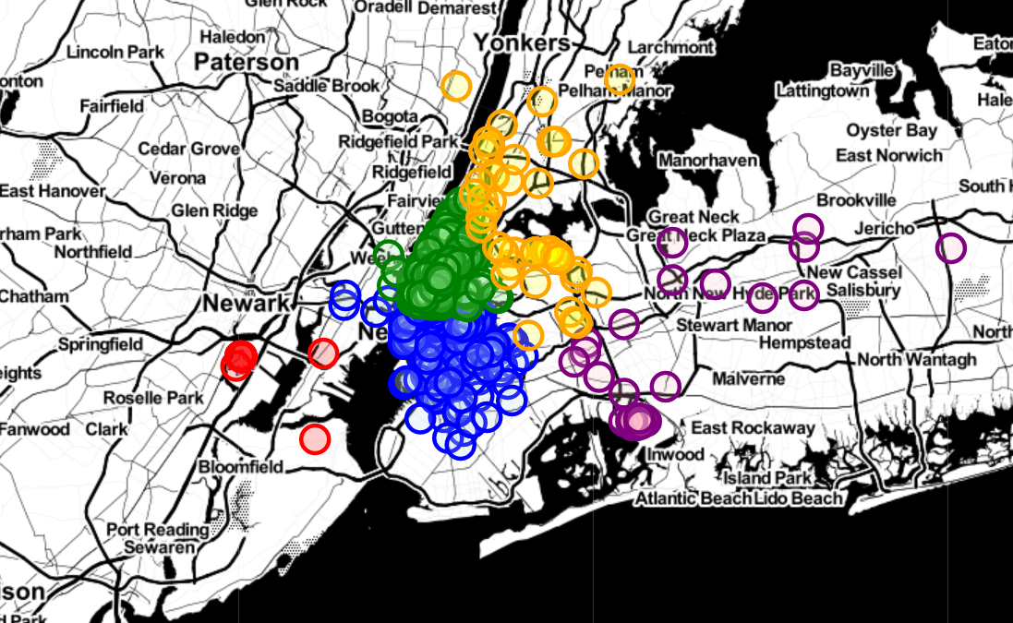
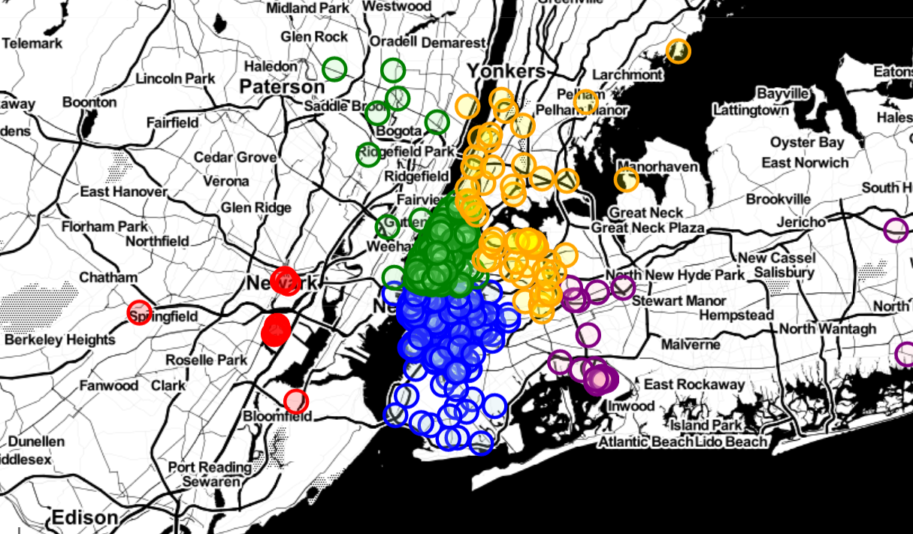
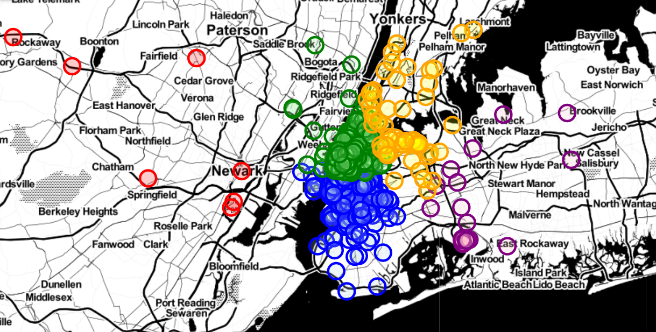
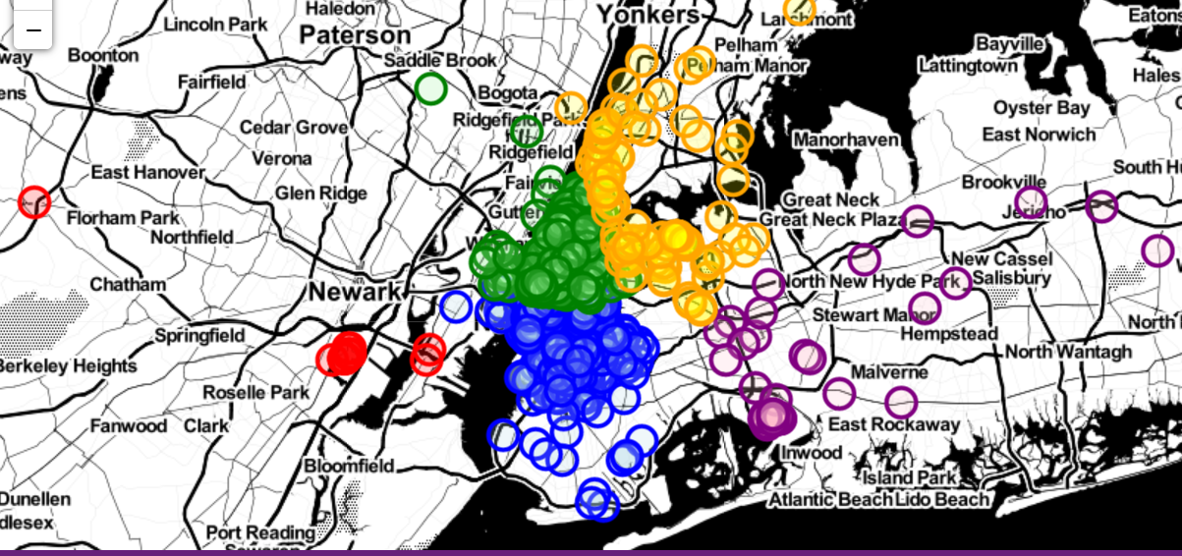
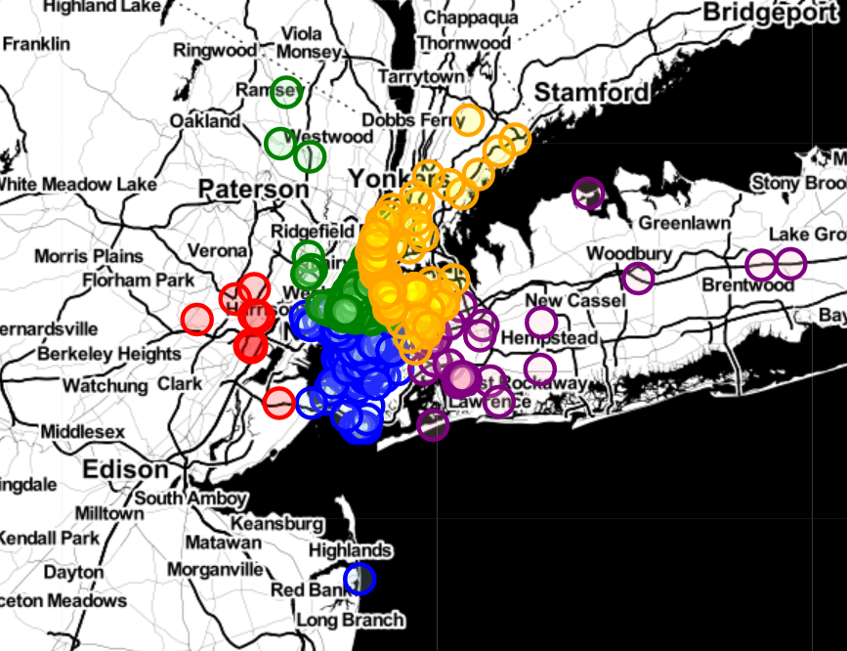
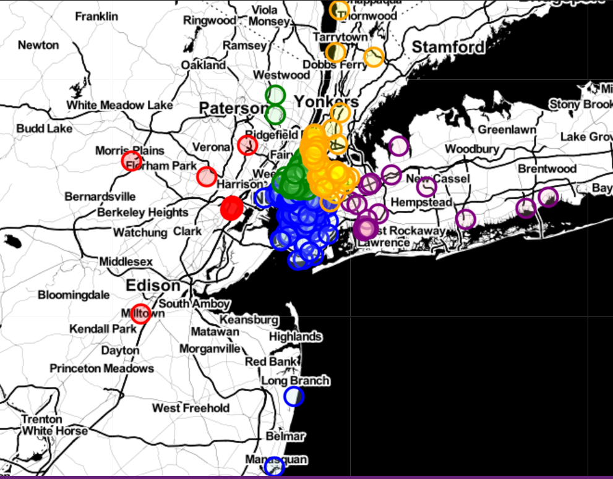
Monday | Tuesday | Wenesday | Thrusday
Friday |  | Saturday | Sunday

Slide 15
Model comparation 1st result
kmeans | DBSCAN | Agglomerative
Silhouette Coefficient is equal to: -0.17750887075097677 Variance Ratio Craterion is equal to: 64.5790620694186 Davides Bouldin score is equal to: 6.581534783853618 | Silhouette Coefficient is equal to: 0.949388865256884 Variance Ratio Craterion is equal to: 173566.98599072578 Davides Bouldin score is equal to: 0.06742862221097078 | Silhouette Coefficient is equal to: 0.9592980231695665 Variance Ratio Craterion is equal to: 318871.9788931079 Davides Bouldin score is equal to: 0.13579540621408642
2nd result
Silhouette Coefficient is 0.3850332568988621 | Silhouette Coefficient is 0.25207451733075925 | Silhouette Coefficient is 0.35911820899985303

Slide 16
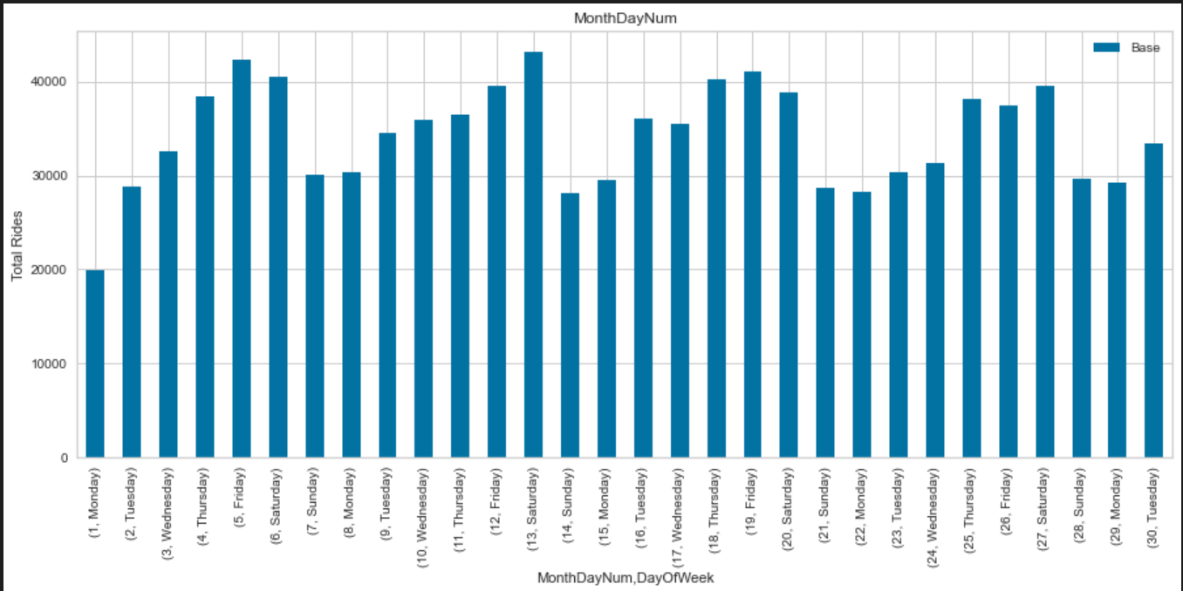
Prediction for september
Daily rides of the month

Slide 17
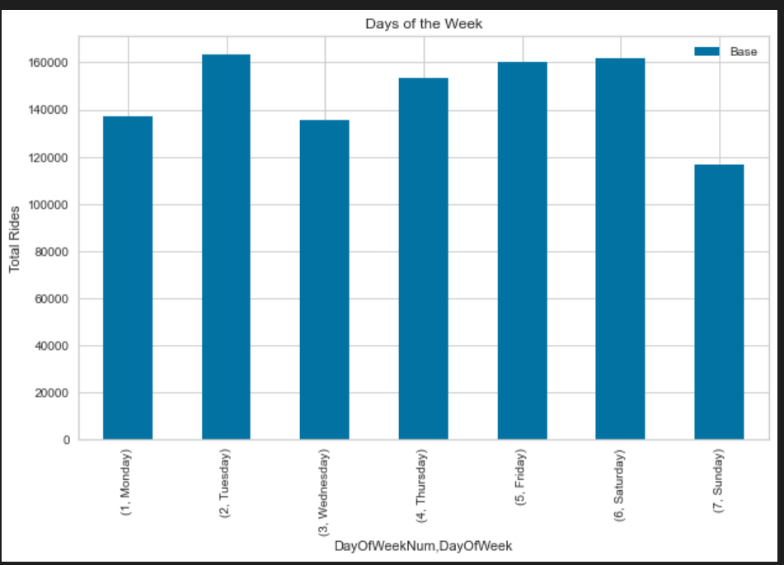
Daily rides of a week

Slide 18
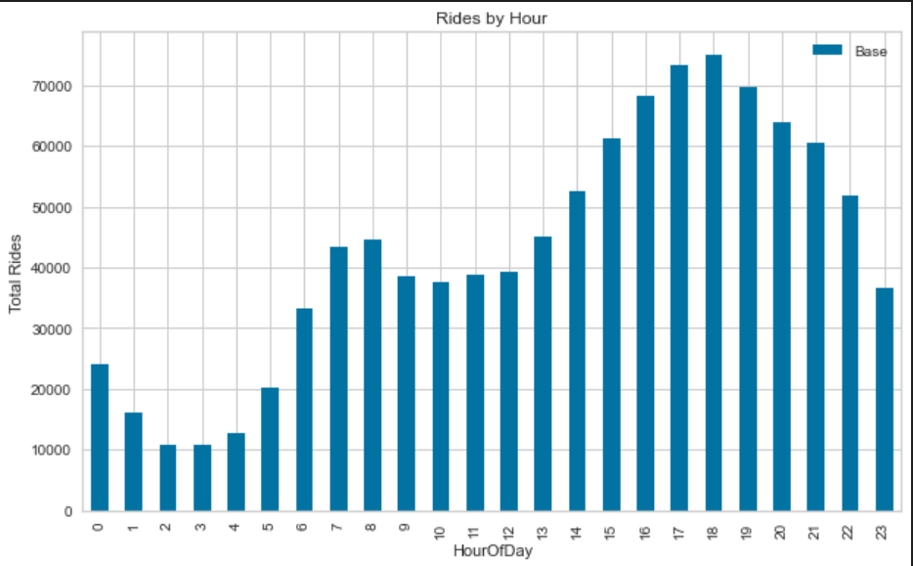
Hourly rides in a day

Slide 19
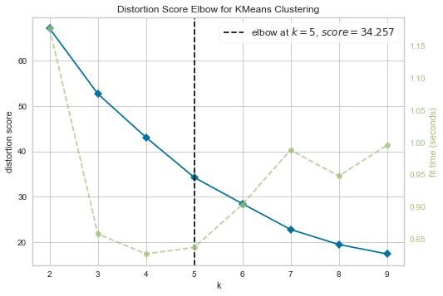
Elbow method

Slide 20
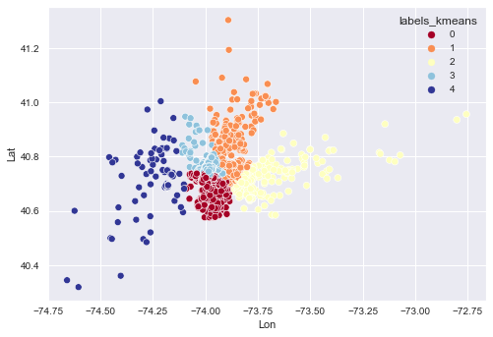
KMEANs Model

Slide 21
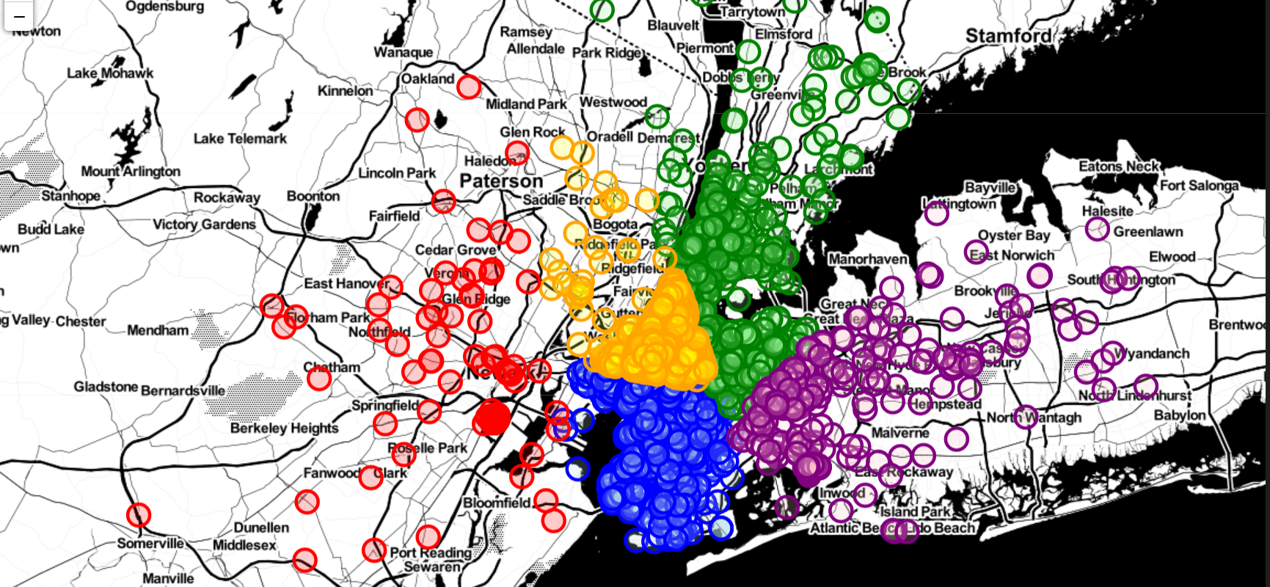
Kmeans folium Map

Slide 22
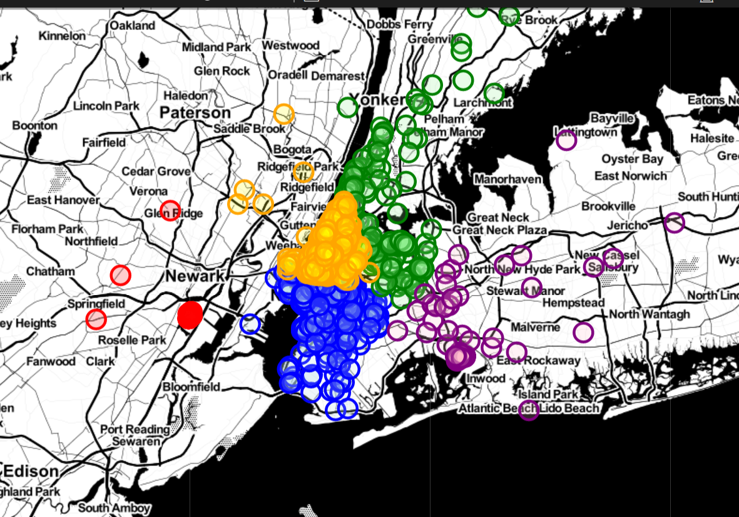
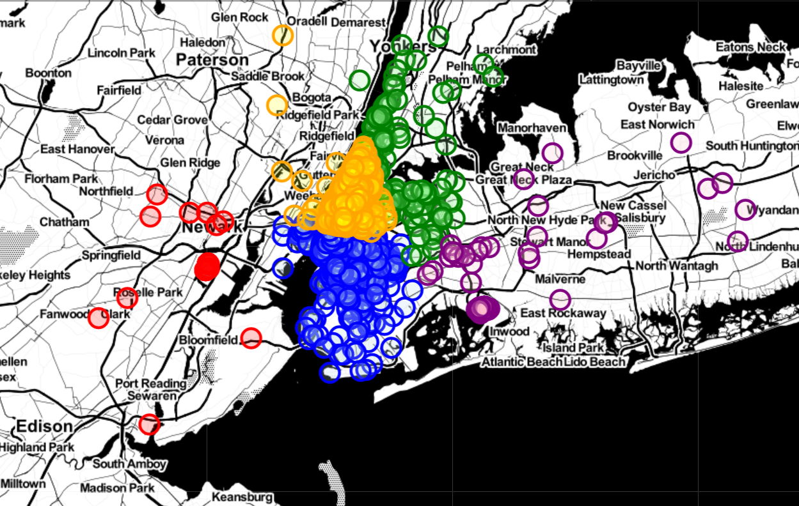
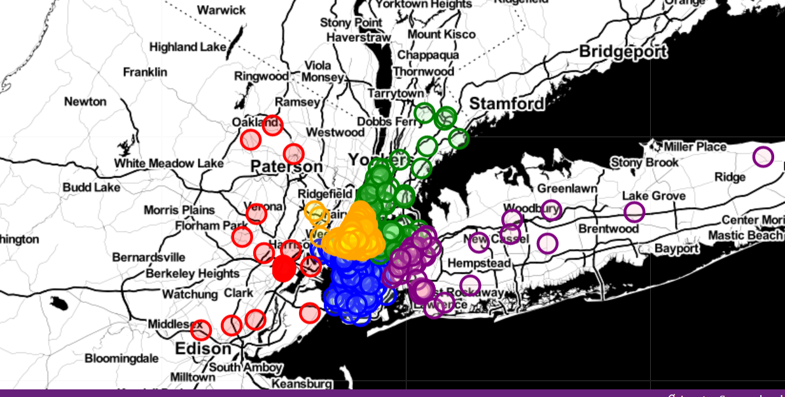
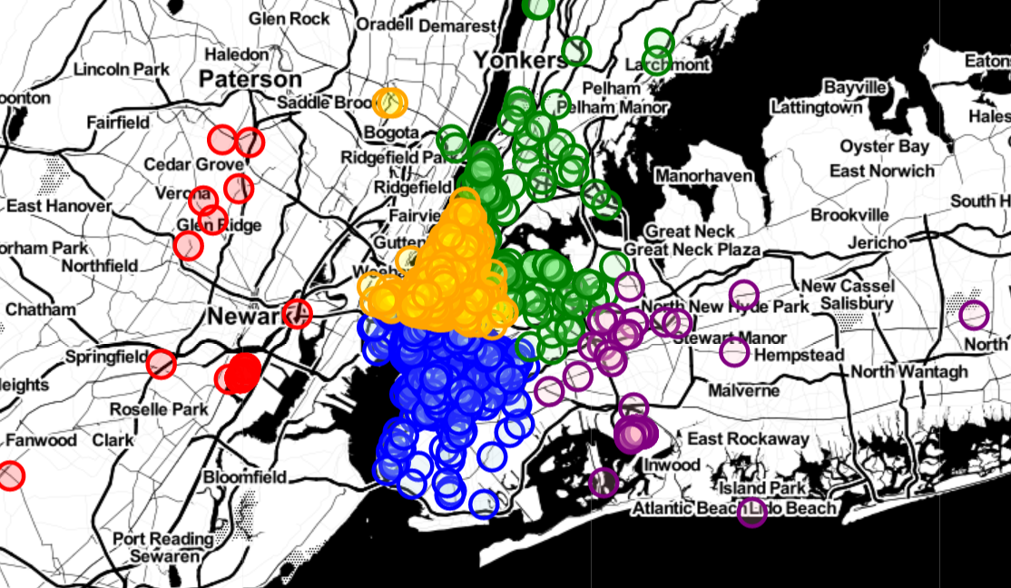
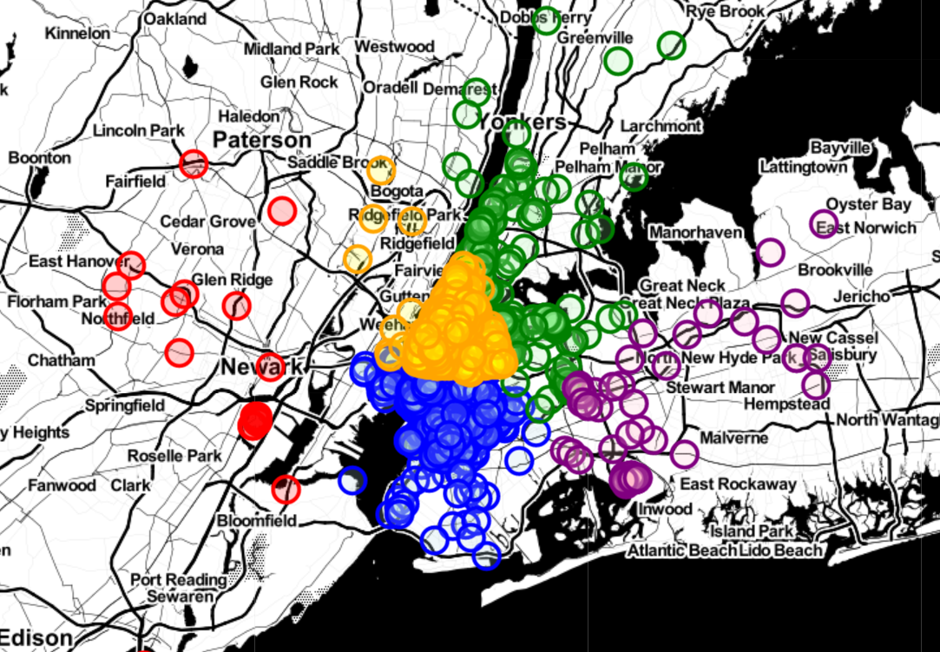
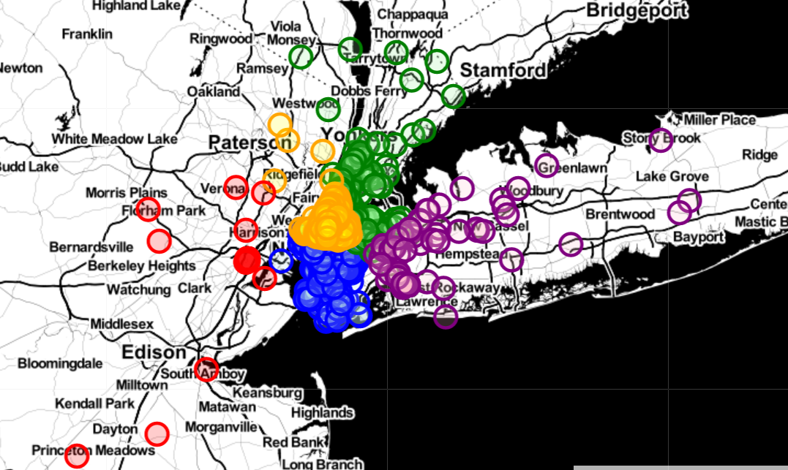
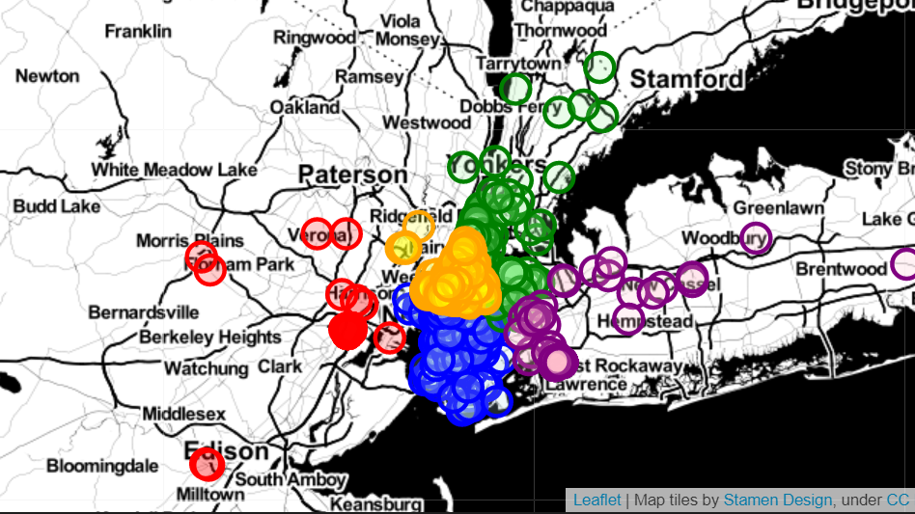
Monday | Tuesday | Wenesday | Thursday
Friday |  | Sarturday | Sunday

Slide 23

Q & A

